Slide 1
Improving Efficiency for String Similarity Searches through Clustered Pruning
Kyle Patterson, James Fitzpatrick

Slide 2
Original Idea
Comparing VGRAM and Top-K
Build clusters on strings based on LCS
Trim search space by clusters
Compare Naïve VGRAM/Top-K versus trimmed search space

Slide 3
Problems!
Clustering was way too difficult for the time and computing restraints
Tried building an InvertedList based on LCS instead, similar to clustering
List construction was doable, but in the end took
Could be useful for situations with low amounts of memory, but it takes a long ass time to make

Slide 4
Top-K Concepts

Slide 5
VGRAM Concepts

Slide 6
Clustering Concepts

Slide 7
Difference Matrix

Slide 8
Initial attempts at clustering

Slide 9
InvertedList concepts

Slide 10
InvertedList Implementation

Slide 11
Experimental Setup

Slide 12
Testing and Evaluation

Slide 13
Results

Slide 14
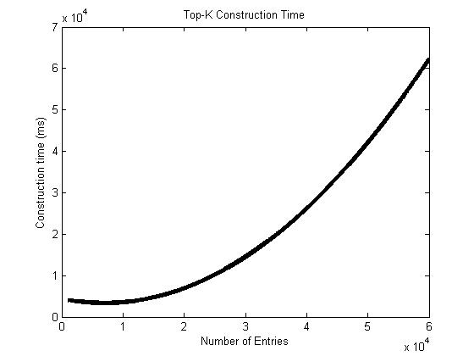
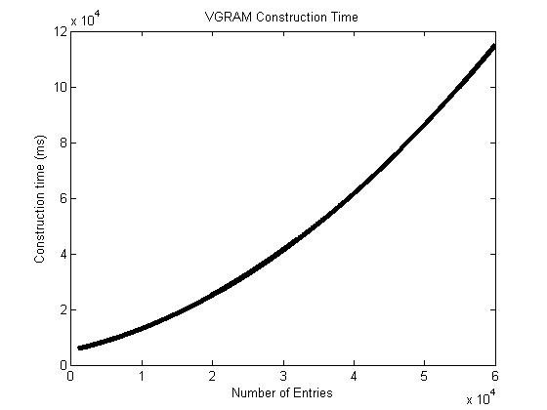
Trie Construction Times

Slide 15
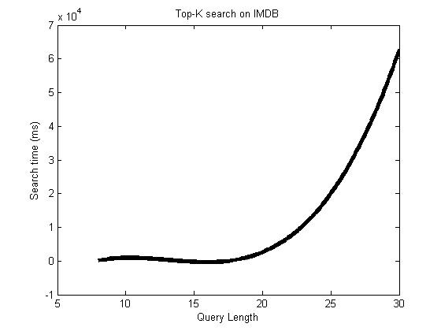
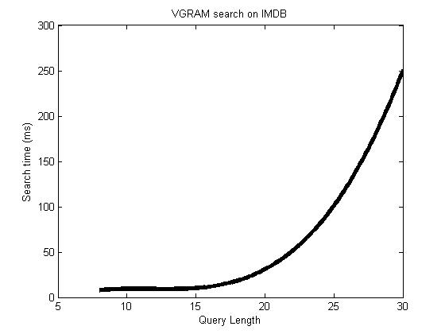
Query Time on IMDB – naïve

Slide 16
Something about pruning with InvertedList

Slide 17
Conclusion
Clustering would probably be great, if it were less computationally expensive
Inverted Lists are also great, but constructing based on LCS is very expensive

